Slide 1
Yelp Data Set Analysis
By - Nayyar unda
Jiwei Li
Li Ma
Zhillong Hou

Slide 2

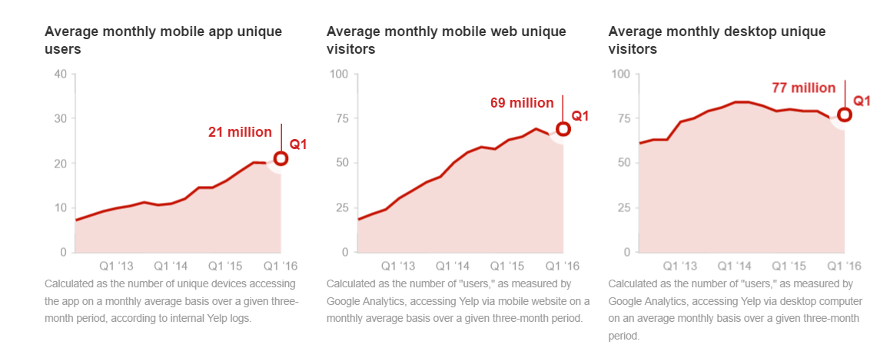
Data set : 2.3 gb’s of user generated content
2.2 M reviews, 552k users, 77k business in 10 cities across 4 countries

Slide 3
Project Objective
Analyse User’s rating habit and re-rate each business
Categorize review’s attitude based on review dataset by implementing NLP(Naïve Bayes)
Analyze seasonal effect on each business
Build Web search engine with Google Map API to integrate the project as a business recommender based on user’s input

Slide 4
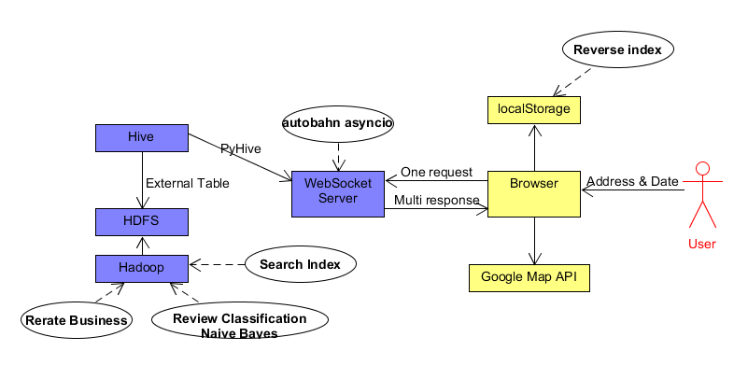
Architecture

Slide 5
Review Classification

Slide 6
Purpose
Sometimes we cannot get real attitude from the score that the users give to the business.
However, we can get more information from the users’ reviews by text classification.
Our goal is to classify the review as positive and negative.

Slide 7
Choices
NLTK(Natural Language Toolkit) and Stanford CoreNLP. Good to process natural language and sentiment analysis But it is cumbersome to load all the dictionary to every node.
Applying Naive Bayes in MapReduce Building own dictionary, dividing it into several blocks and storing in HDFS
Mahout Have a Naive Bayes Package

Slide 8
Total number of reviews : 5
Number of Positive reviews: 3
Number of Negative reviews: 2
P(+) = 3 / 5
P(-) = 2 / 5
Review_id | Text | Class
1 | I loved the food | +
2 | I hated the food | -
3 | A great restaurant. Great service | +
4 | Poor service | -
5 | Great wine. A great restaurant | +

Slide 9

Naive Bayes
Calculate The Number of Word In Positive Reviews
For example: P(great | +) = (2 + 1) / (12 + 12) = 1 / 8
n , The number of words in positive reviews : 12
vocabulary, The number of unique word : 12
w, The number of times the word occurs in the positive reviews
Reivew_id | I | loved | the | food | hated | a | great | poor | restaurant | service | wine | class
1 | 1 | 1 | 1 | 1 |  |  |  |  |  |  |  | +
3 |  |  |  |  |  | 1 | 1 |  | 1 | 1 |  | +
5 |  |  |  |  |  | 1 | 1 |  | 1 |  | 1 | +

Slide 10
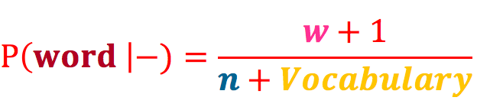
Naive Bayes
The same way to compute the word probability given negative
Compute word probability given negative by applying the formula :
For example: P(I | -) = (1 + 1) / (12 + 6) = 1/9
P(food | -) = (1 + 1) / (12 + 6) = 1/9
n , The number of words in negative reviews : 6
vocabulary, The number of unique word : 12
w, The number of times the word occurs in the negative reviews
Reivew_id | I | loved | the | food | hated | a | great | poor | restaurant | service | wine | class
2 | 1 |  | 1 | 1 | 1 |  |  |  |  |  |  | -
4 |  |  |  |  |  |  |  | 1 |  | 1 |  | -

Slide 11


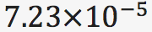
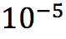
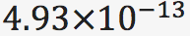
Naive Bayes
review = “I loved the restaurant”
P(review |+) = P(+) * P(I|+) * P(loved|+) * P(the|+) * P(restaurant|+)
= 3 / 5 * 1 / 12 * 1 / 12 * 1 / 12 * 1 / 6 ≈
P(review |- ) = P(-) * P(I|-) * P(loved|-) * P(the|-) * P(restaurant|-)
= 2 / 5 * 1 / 9 * * 1 / 9 * ≈
P(review | +) > P(review | -)
Then This review is probably positive.

Slide 12
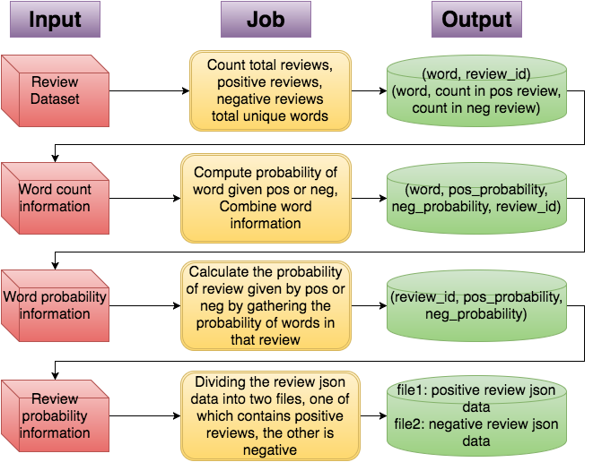

Slide 13
Re-rate and Index the Business

Slide 14
Why Re-rate each business?
Yelp rates each business simply by get the average rate from all users’ reviews, which can be considered as biased.
There might be seasonal effect on each business’s performance(Lobster season for seafood restaurant).
For the delivery, we want to make a search engine which can index “the best” place near user’s input location

Slide 15

Data Processing Segment
User DataSet
Active/Inactive:
User’s review count less than 5
Have no fans
Not an elite member
Has no friends, votes and compliments
Filter out inactive user
Clean Review Dataset,
Re-value each reviews based on user’s rating history(habit)
Review DataSet
Rating Habit:
Consider only the user who has lots of reviews
Set Rating Offset= +1 if the user is less likely to give high scores(4-5 stars)
Set Rating Offset= -1 if the user is less likely to give low scores(1-2 stars)
Re-rate business score based on Re-valued reviews, overall and monthly
Business DataSet

Slide 16
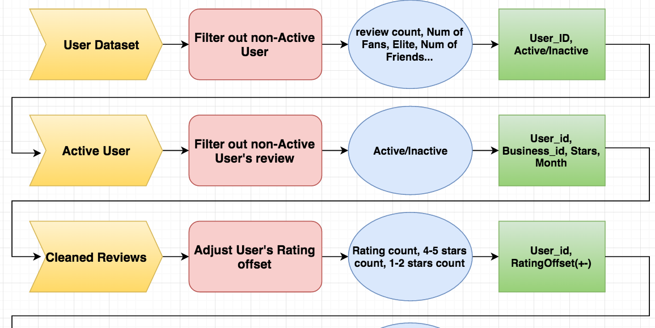
MapReduce Process
Input
Function
Based On
Output
Step.1
Step.2
Step.3

Slide 17
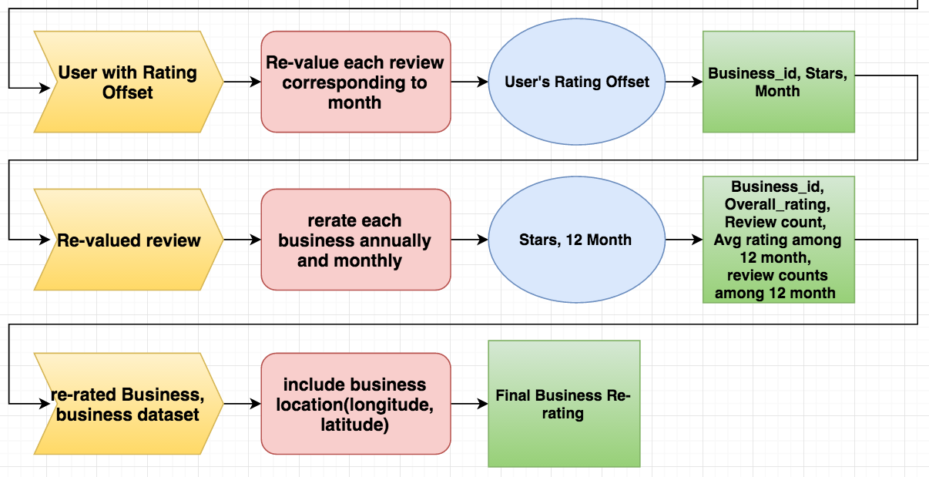
MapReduce Process
Input
Function
Based on
Output
Step.4
Step.5
Step.6

Slide 18
WebSocket & LocalStorage

Slide 19
Intro
Getting data from hiveserver is very very slow! Especially, when using join query. Because it may trigger MapReduce job, which will take a little while.
We slice join query to several simple queries, build a search index, use websocket to exchange data between server and browser and store all data from server in LocalStorage of browser to make the response faster.

Slide 20
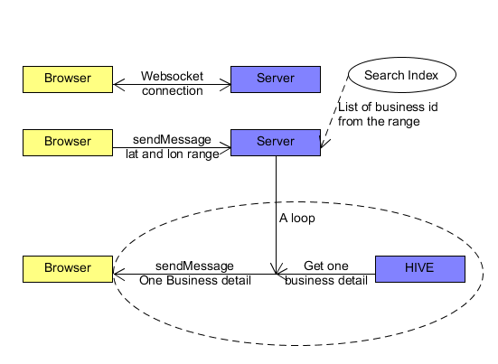
WebSocket
When the web page is opened, browser connect to Server.
Browser send one request to server
Server get a list of business from search index and get business detail and send to browser one by one.
Brower will get business details one by one, and show each business detail when get it.

Slide 21
LocalStorage
localStorage.setItem( Business_id, Business detail);
{ 'type': 'business', 'business_id': (encrypted business id), 'name': (business name), 'neighborhoods': [(hood names)], 'full_address': (localized address), 'city': (city), 'state': (state), 'latitude': latitude, 'longitude': longitude, 'stars': (star rating, rounded to half-stars), 'review_count': review count, 'categories': [(localized category names)] 'open': True / False (corresponds to closed, not business hours), }
Store business detail to localStorage
Build reverse index for categories in localStroage
All data will be stored in localStroage of browser. User can sort, filter existing data without send and get data from server. We use this technique in our category change function.
localStorage.setItem( “cate:”+ category name, Business_id)
reverse index

Slide 22
Thanks!

Slide 23
FURTHER WORK: REFLECTION:
Improve Classification Algorithm
Improve Websocket responding time
Should co-work on Github for integration efficiency and version control

Slide 24

Thanks!

